Slide 1
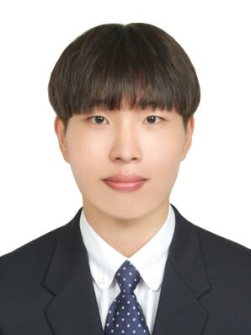
About Me
Profile
Education Histroy
Birth : 1994.04.02
Tel. : (+82)-10-6653-8277
Email : gjsgud2@gmail.com
Github : https://github.com/suyeony0/
Catholic University of Korea (graduated) FEB.2020
Ogeum High School (graduated) FEB.2013
Language Study (London - UK) FEB.2018 ~ AUG.2018
HeonHyung Lee
Computer Engineer
Skills
ExtraCurricular
English : TOEIC(940), OPIC(AL), TEPS(374)
Programming Language : C++, python
[Big Contest] - Champions League Jul.2019 – Sep.2019
[Space Weather] – AI Contest Aug.2019 – Sep.2019
[Kaggle] - Predicting Future Sales Nov.2019 – Dec.2019
https://drive.google.com/drive/folders/1N1QyCkOQW1fPncfWZOcNehhRr2ZDc8Zo?usp=sharing
Undergraduate Research Student Feb.2019 ~ Feb.2020
-Mediation of Color in Odor – Emotion Association (accepted by Kiise)
http://www.dbpia.co.kr/journal/articleDetail?nodeId=NODE08763620
[3D game] – Escape Room(openGL) Oct.2019~Dec.2019
https://suyeony0.github.io/EscapeRoom/
[Algorithm] - https://github.com/suyeony0/Leetcode-Algorithm
Honors
Summa cum laude (the highest honor)
- GPA : 4.45 / 4.5
Notes:
Download more minimal templates here: https://crmrkt.com/GK9Dwa

